Slide 1

Performance Analysis of Underwater optical wireless communication
Subham Supriya Padhi (B219056)
Rajesh Kumar Samal (B219045)
Dheeraj Geddam (B219022)
Under the supervision of
Dr. Rajat Kumar Giri
Dept. Of Electronics & Telecommunication Engineering
International Institute of Information Technology, Bhubaneswar
Date: 24.05.2023

Slide 2
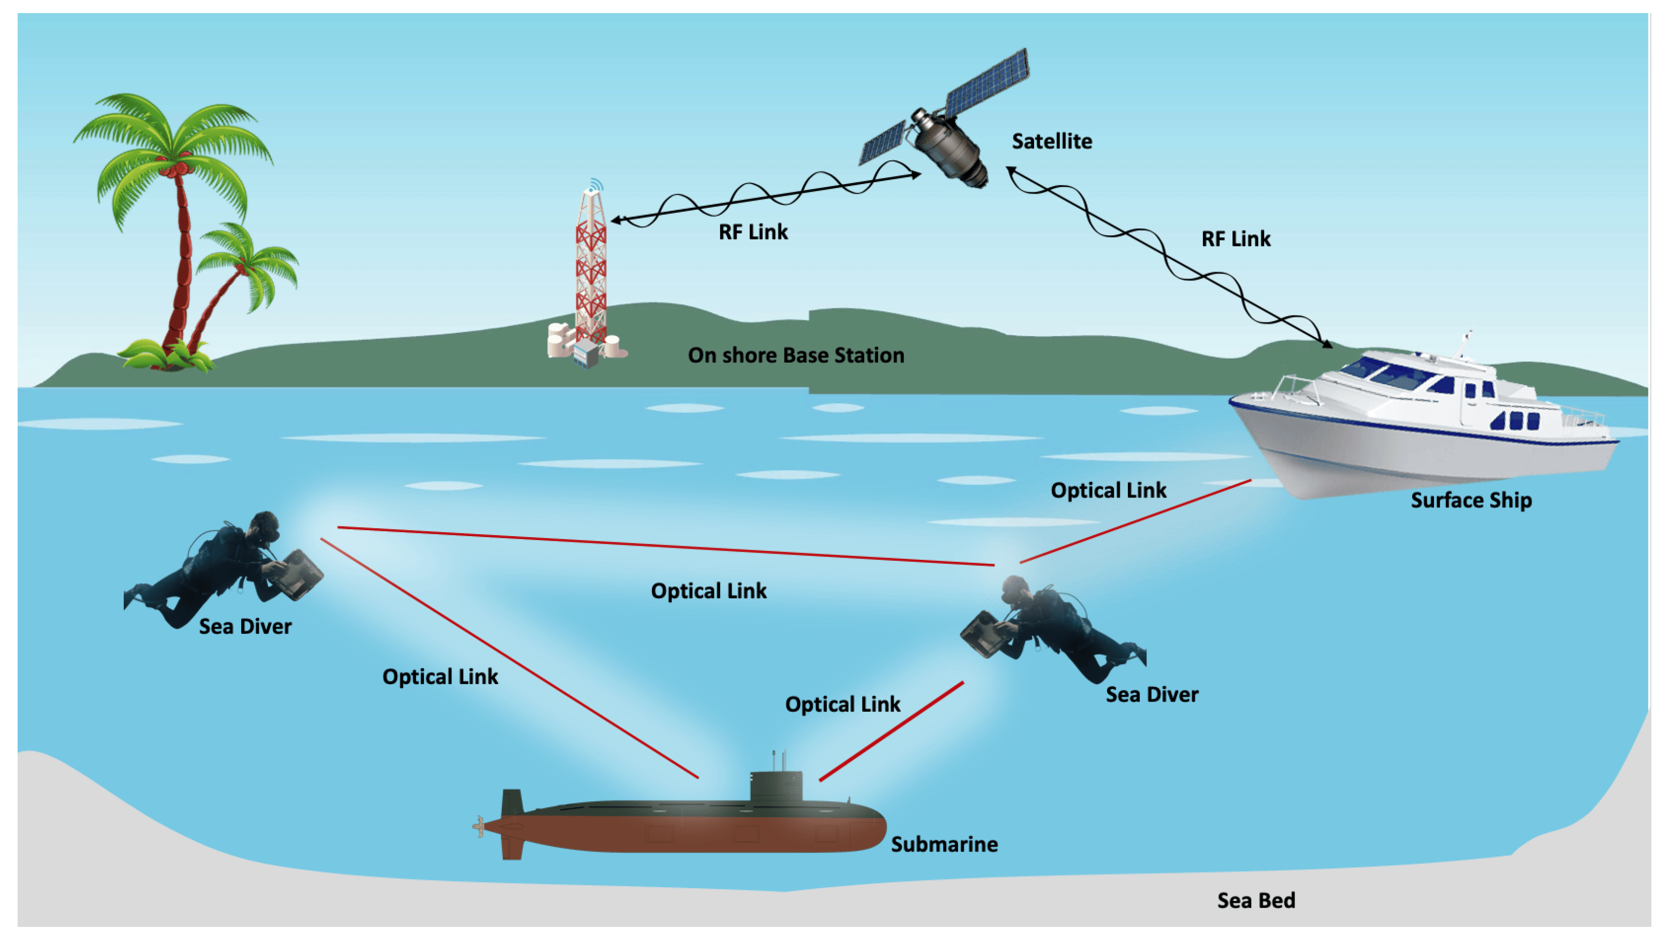
Introduction
Underwater Optical Wireless Communication (UOWC) refers to a method of communication that uses light to transmit data through water. It is a technology that enables communication between underwater devices, such as underwater vehicles, sensors, or buoys, using optical signals.
UOWC takes advantage of the fact that light can travel relatively long distances in clear water compared to RF signals. It typically uses modulated light signals, such as LEDs or lasers, to encode and transmit data through water. Photodetectors at the receiving end capture the light signals and convert them back into usable data.

Slide 3
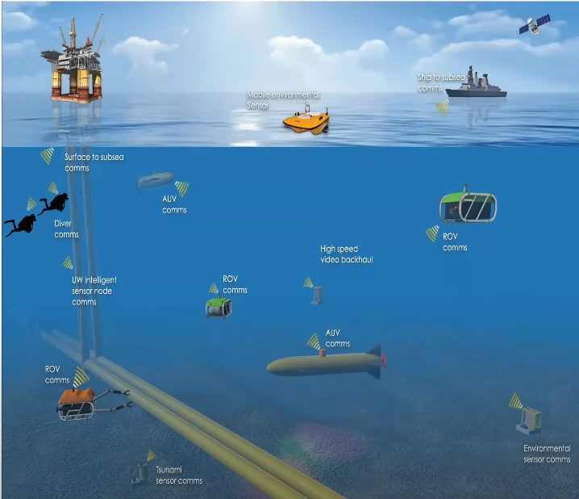
Underwater wireless communication
Ocean monitoring (climate, environment, fisheries).
Underwater exploration (oil and gas, mining).
Search and survey (shipwrecks, sea floor, mapping).
Diver commuincation.
Defence application.

Slide 4

Motivation
Overcoming limitations: UOWC aims to overcome the limitations of traditional underwater communication methods, such as acoustic and RF, by providing higher data rates, longer range, and improved efficiency.
Increased bandwidth: UOWC utilizes a wide spectrum, particularly the blue-green region, offering larger bandwidth for higher data transfer rates and capacity, enabling real-time applications and handling large data volumes.
Reduced interference: UOWC operates in the optical spectrum, providing a relatively interference-free communication channel in crowded underwater environments, improving reliability and communication quality.
Enhanced security: Optical signals in UOWC are highly directional and can be confined within a narrow beam, providing inherent security against eavesdropping and interception, making it suitable for secure communication in sensitive underwater applications.
Compatibility with existing technologies: UOWC leverages off-the-shelf commercial electronics components, making it accessible, cost-effective, and easier to integrate with other underwater systems, enabling seamless compatibility with existing technologies.

Slide 5
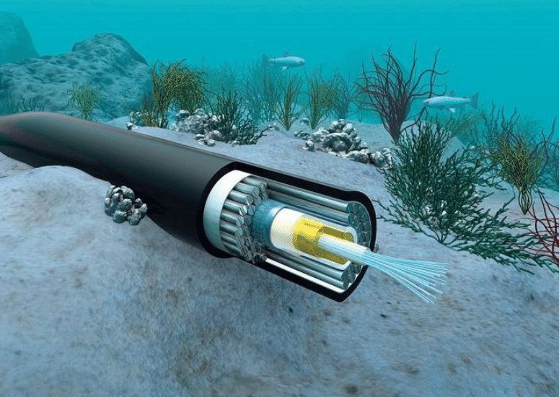
Wired Communication
Using a cable connection to directly communicate with devices, such as remotely operated vehicles (ROVs), provides real-time visual feedback, control, and the ability to gather and manipulate real-time data, benefiting from a larger power budget due to the power supply over the same cable.
Despite its advantages, the cable connection approach for underwater communication has drawbacks including maintenance challenges, high installation costs, limited space based on wire length, and susceptibility to breakage or entanglement in harsh underwater conditions.

Slide 6
Acoustic
1. Uses sound waves for transmitting and receiving information between underwater devices and surface stations.
2. Used in ocean monitoring, underwater military operations, robots, and marine research due to its long-distance capabilities.
3. Has limitations like lower data rates (kilobits per second) and significant propagation delays.
4. Are large, expensive, and energy-intensive, limiting their suitability for large-scale underwater wireless sensor networks.
5. Can impact marine life, which is a critical consideration in underwater ecosystems.

Slide 7
Radio Frequency
1. RF wireless underwater communication uses radiofrequency waves for data transmission and reception underwater but faces limitations due to water's conductivity and antenna design complexities.
2. Radio waves offer advantages of integrating terrestrial and underwater RF systems and better resistance to water turbulence, but data transmission rates remain slow.
3. Challenges include limited range and slower speeds compared to other communication methods.
4. Despite these obstacles, underwater RF communication holds potential for improved connectivity in underwater environments.

Slide 8
Optical Communication
1. Researchers sought a solution to overcome the limitations of existing wireless techniques, such as large antennas, high power requirements, and attenuation in saltwater for RF communications.
2. Optical wireless communication (OWC), particularly using visible light, emerged as a promising alternative to address these challenges, leading to the growth of underwater optical wireless communication (UOWC) in recent years.
3. UOWC utilizes off-the-shelf commercial electronics components to reduce device complexity, cost, and power consumption, making it an attractive option.
4. Optical wireless communication involves data transmission using unguided propagation of light across the optical spectrum, with the blue-green wavelength region (450-550 nm) offering the least attenuation underwater, driving the increased interest in underwater OWC.

Slide 9
Comparison Table between Acoustic, RF and Optical communication techniques
 | Acoustic | RF | Optical
Attenuation | High | Mid | Low
Speed | 1500 m/s | 2.2*10⁸ m/s | 2.2*10⁸ m/s
Data rate | Kbps | Mbps | Gbps
Latency | High | Mid | Low
Distance | ~kms | 10m | ~kms
Bandwidth | Hz, kHz | ~MHz | (10-150) MHz
Frequency Band | 10-15 kHz | 30-300 Hz | 10¹²-10¹⁵ Hz
Transmission Power | Tens of watts | Few mW to 100 W | Few watts
Antenna Size | 0.1m | 0.5m | 0.1m
Efficiency | 100 bits/J |  | 30000 bits/J
Performance Parameter | Temperature, Salinity, Pressure | Conductivity, Permittivity | Absorption, Scattering, Turbidity

Slide 10
Challenges in Underwater Optical Communication
Light Propagation in Water
Optical Properties
IOPs
AOPs
Absorption coefficient
a(λ)
Scattering
Coefficient
b(λ)
Attenuation
Coefficient
c(λ)
Radiance
Irradiance
Reflectance
- Propagation of light will decrease
- Limit the link distance
This will spread the light beam which results in the reduction of photons and the SNR decreases

Slide 11
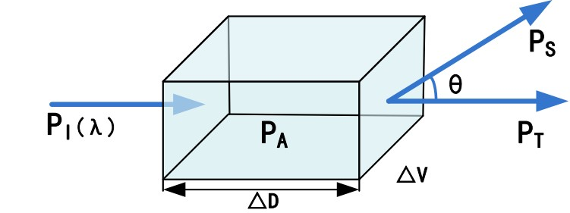
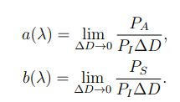
Propagation of light
P_{I} = P_{A} + P_{S} + P_{T .}
Fig. Geometry of inherent optical properties for a volume ∆V
P_{A} absorbed power
P_{S} dispersed power
P_{T} and transmitted power
c(λ) attenuation coefficient
∆V amount of water
∆D length of the cuboid
λ wavelength
a_{w}(λ) absorption due to pure seawater
a_{CDOM} (λ) absorption due to CDOM
a_{phy}(λ) absorption due to phytoplankton
a_{det}(λ) absorption due to detritus.
b_{w}(λ) scattering due to pure seawater
b_{phy}(λ) scattering due to phytoplankton,
b_{det}(λ) scattering due to detritus
a(λ) = a_{w}(λ) + a_{CDOM} (λ) + a_{phy}(λ) + a_{det}(λ)
b(λ) = b_{w}(λ) + b_{phy}(λ) + b_{det}(λ)
c(λ) = a(λ) + b(λ)

Slide 12

Types of Water
1. Pure seawater: Low scattering enables almost straight beam propagation. However, absorption still predominates in these areas, causing greater signal loss than scattering.
2. Clear ocean water: Due to the large concentration of dissolved particles, scattering is the main factor, which significantly reduces the total signal.
3. In coastal ocean water, phytoplankton-induced absorption is the main limiting factor, and the best wavelengths for transmission are mostly green.
4. Turbid harbour water: Due to suspended particles and colour dissolved organic matter (CDOM) such fulvic and humic acids, strong absorption in blue wavelengths occurs.

Slide 13
TYPICAL VALUES OF a(λ), b(λ), AND c(λ) FOR DIFFERENT WATER TYPES
Water types | a(λ) (m⁻¹ ) | b(λ) (m⁻¹ ) | c(λ) (m⁻¹ )
Pure sea water | 0.053 | 0.003 | 0.056
Clear ocean water | 0.114 | 0.037 | 0.151
Coastal ocean water | 0.179 | 0.219 | 0.298
Turbid harbor water | 0.295 | 1.875 | 2.17

Slide 14

Implementation
OptiSystem Simulation Software, a full programming suite created for creating, testing, and simulating optical connections in complex optical systems, is used to carry out the simulation.
Parameters | Values
Bit rate | 5 Gbps
Modulation | NRZ
Distance | (1.5, 2.0, 2.5,3.0, 3.5)km
Power | 20mW
Simulation Parameters

Slide 15
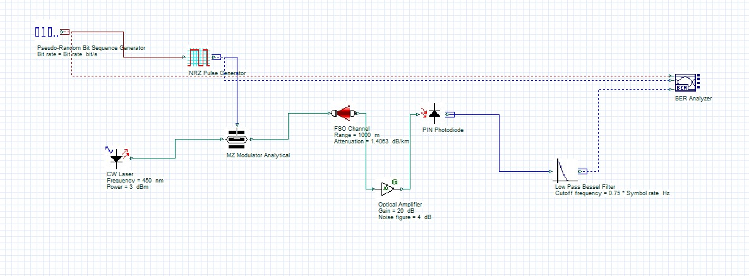
Optisystem Design

Slide 16
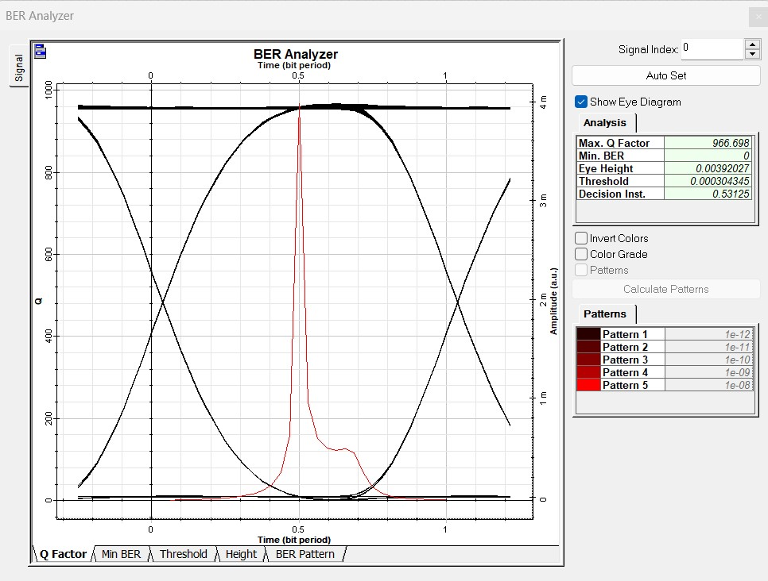
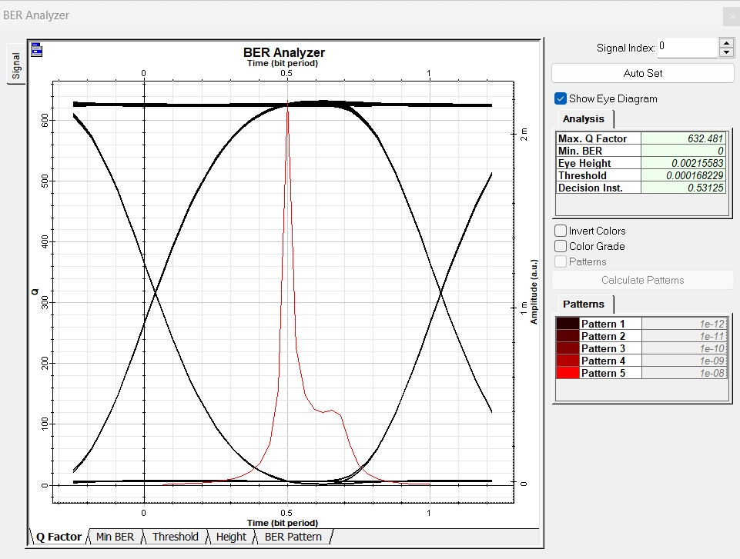
Eye Diagrams
Eye diagram for pure sea water at1500m @5Gbps
Eye diagram for pure sea water at 2000m @5Gbps

Slide 17
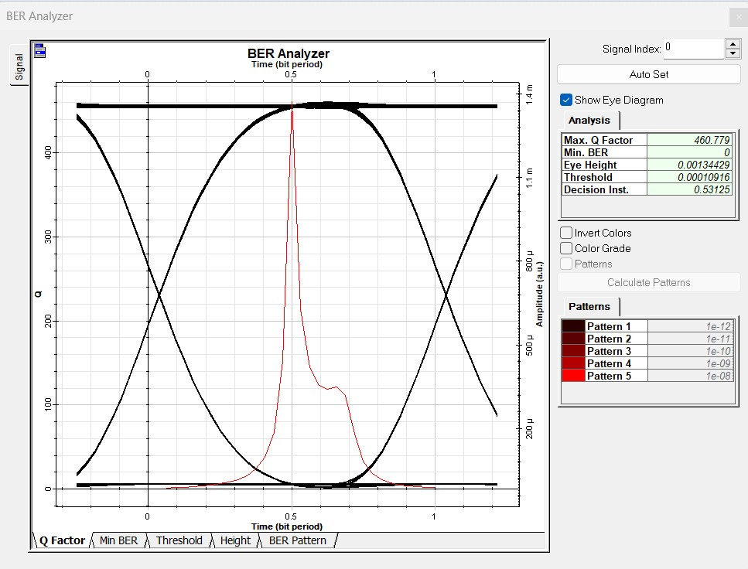

Eye Diagrams
Eye diagram for pure sea water at 2500m @5Gbps
Eye diagram for pure sea water at 3000m @5Gbps

Slide 18
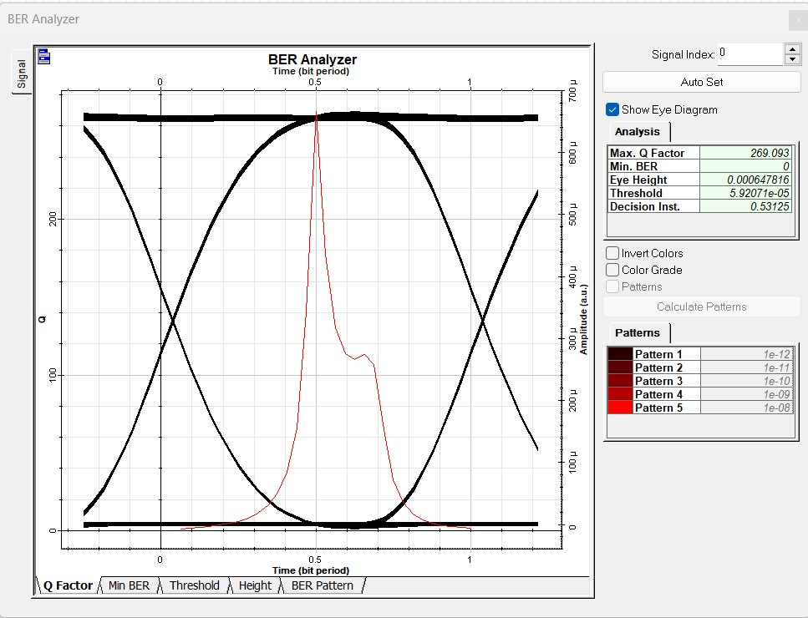
Eye Diagrams
Eye diagram for pure sea water at 3500m @5Gbps

Slide 19
Impact on Q-factor with transmission distance for NRZ modulation
Distance(m) | Types of water & their corresponding Q-factors
 | Pure sea water | Clear Ocean water | Coastal Ocean water | Turbid Harbor Water
1500 | 966.6 | 856.1 | 847.4 | 749.9
2000 | 644.9 | 590.6 | 528.1 | 429.6
2500 | 460.7 | 382.3 | 360.7 | 281.8
3000 | 349.2 | 295.9 | 247.5 | 178.5
3500 | 269.09 | 220.9 | 182.09 | 120.8

Slide 20
Graph between Q-factor & Distance(m)

Slide 21

Conclusion
UWC is used in underwater monitoring, research, response, and military activities.
UWC utilizes acoustic, RF, and optical waves for underwater data transfer.
UWOC in the blue-green spectrum offers higher bandwidth and data throughput.
Factors like noise, optical properties, and propagation impact UWOC performance.
The article covers system design, advantages, disadvantages, and key components of underwater optical communication.

Slide 22

Future Scope:
1. UWOC research has advanced in academia and industry, but unresolved challenges remain.
2. Field research and testbeds are needed to understand the underwater environment and channel characteristics.
3. Obstacles include link misalignment, theoretical modeling of laser beam propagation, transceiver noise effects, and the need for network protocols.
4. Addressing these issues is crucial for the progress and realization of UWOC's potential in underwater communication systems.

Slide 23
References
[1] Ashok Reddy1, J Rajani Kanth2, D Muneendra– “Under Water Optical Wireless Communication” ISSDN No.:978-1-6654-9529-5/22/$31.00 ©2022 IEEE
[2] Yuhan Dong, Jinxing Liu ― “On BER Performance of Underwater Wireless Optical MISO Links under Weak Turbulence” published by- IEEE ISSDN No. : 978-1-4673- 9724-7, 2016.
[3] Zhaoquan Zeng, Huihui Zhang, Student Member, IEEE, Yuhan Dong, Member, IEEE, Julian Cheng, Senior Member, IEEE,- “A Survey of Underwater Wireless Optical Communication” DOI: 10.1109/COMST.2016.2618841
[4] P. Vijayakumari, K.Chanthirasekaran, Jayamani KNirmala P, R. ThandaiahPrabu- “BIT Error Rate Analysis of Various Water Samples in Underwater Wireless Optical Communication System” DOI: 10.1109/ACCAI53970.2022.9752642
[5] Mohammad Vahid Jamali, Student Member, IEEE, Jawad A. Salehi, Fellow, IEEE, and Farhad Akhoundi- “Performance Studies of Underwater Wireless Optical Communication Systems With Spatial Diversity”

Slide 24
Thank You

